Slide 1

TRAVERSING THE IDEASCAPE:
IDEA GENERATION AND PRUNING IN SYNTHETIC SYSTEMS

Slide 2
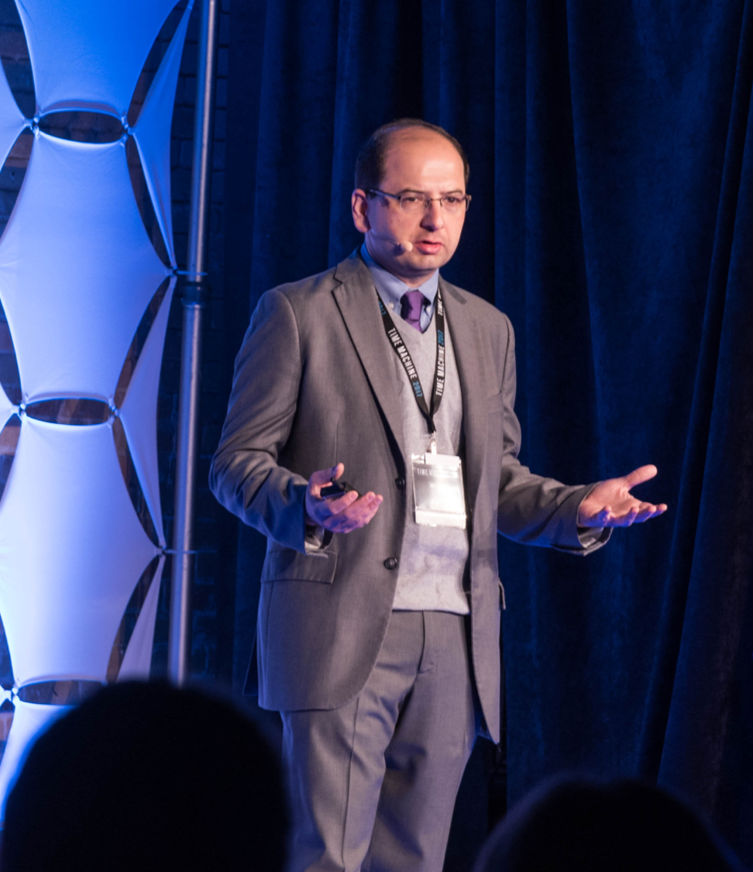

SPEAKER BACKGROUND
Founder & CEO
Board of Advisors
Member AI & Global Security Task Force
@amirhusain_tx

Slide 3

HOW CAN MACHINES THINK?
Logic
John McCarthy and
Marvin Minsky
Genetic Algorithms
John Koza
Artificial Neural Networks
Warren McCulloch and Walter Pitts
@amirhusain_tx

Slide 4
DEEP LEARNING ISN’T THE ONLY KIND OF AI
?
DOG
Learn
Classify
Classification Model
DOG
CAT
Learning from Examples
@amirhusain_tx

Slide 5
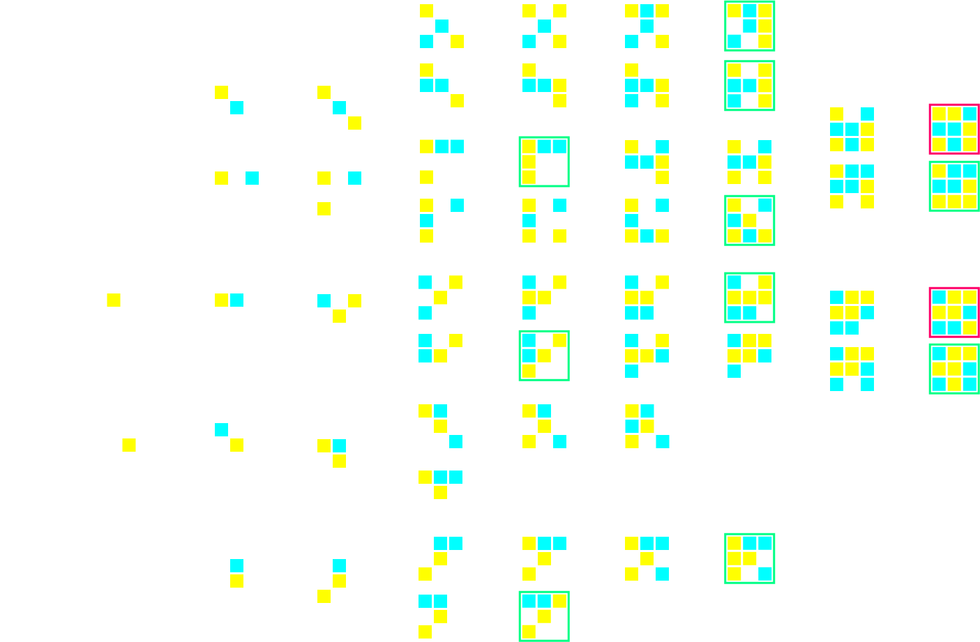
THINKING BY GENERATING AND PRUNING
Three basic rules generate the whole tree:
One symbol at a time
Winning state
Alternate symbols
@amirhusain_tx

Slide 6
THINKING = GENERATING IDEAS + PRUNING?
Ideas can be generated in many ways… random (monkeys on typewriters), heuristic-based generation or deep networks (deep “dreaming”)
Ideas can be pruned in many ways… evaluation against an objective function, try-and-rank (simulations?)… or with deep networks
Basic ”ideate + prune” design pattern can be implemented in simple ways (some Chess players) or sophisticated ways (Generative Adversarial Networks GANs)
@amirhusain_tx

Slide 7
GANs ALSO FOLLOW THE “IDEAS + PRUNING” DESIGN PATTERN
Generator
Input data for training generator
Fake output
Guesses fake/real
Input data for training discriminator
Discriminator
@amirhusain_tx

Slide 8
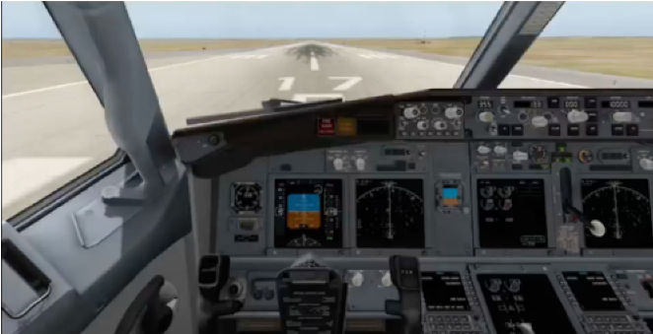
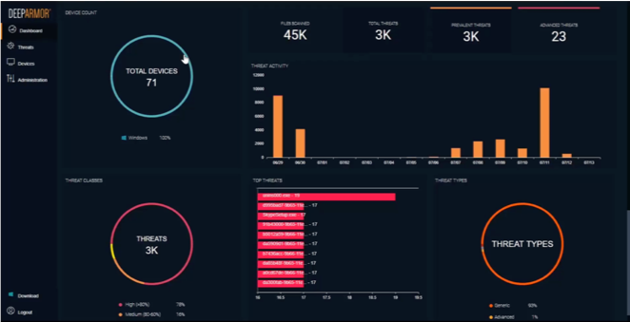
GOOD SUCCESS WITH THIS DESIGN PATTERN
Automated takeoff and making takeoff rejection decisions in aircraft
Generation of training data for Finance and Cybersecurity applications
@amirhusain_tx

Slide 9
REVISITING THREE PROBLEMS IN MACHINE THINKING
Today’s best techniques require too much data
“Millions” of examples
Connectionist systems/neural networks are opaque, not explainable
The problem of intrinsic motivation: How do we get machines to do things for their own sake?
@amirhusain_tx

Slide 10
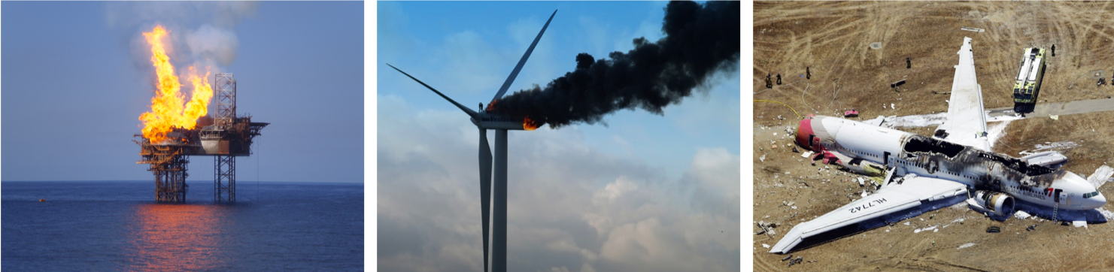
NEEDING TOO MUCH DATA IS A CHALLENGE
Leading handwriting recognition dataset includes 240,000 training samples for the small length alphabet
In practical situations, there just isn’t that much data available
@amirhusain_tx

Slide 11
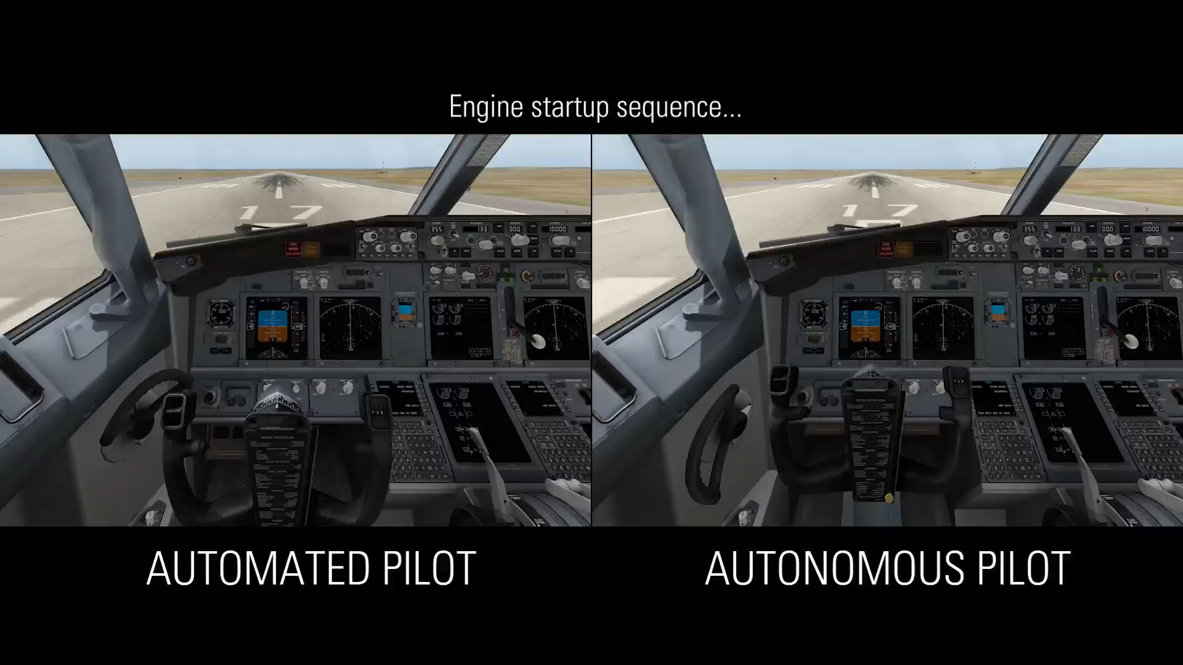
AI BASED TAKEOFF AND RTO DECISIONS
@amirhusain_tx

Slide 12
REVISITING THREE PROBLEMS IN MACHINE THINKING
Today’s best techniques require too much data
“Millions” of examples
Connectionist systems/neural networks are opaque, not explainable
The problem of intrinsic motivation: How do we get machines to do things for their own sake?
@amirhusain_tx

Slide 13
CAN NEURAL PATHWAYS INDICATE ANN FITNESS?
Trained Neural Network
.21
.67
.82
.15
.72
.89
.27
.73
.25
.79
.36
.45
.91
.72
.11
.05
.18
.62
.51
.83
x₀
x₁
x₂
x₃
x₄
x₅
x₆
.
.
.
.
.
.
.
.
.
.
.
.
x_{n}
Untrained, Low quality network
.87
.95
.97
.89
.93
.87
.88
.94
.97
.85
.86
.78
.83
.84
.86
.98
.78
.93
.84
.83
y₀
y₁
y₂
y₃
y₄
y₅
y₆
.
.
.
.
.
.
.
.
.
.
.
.
y_{n}
@amirhusain_tx

Slide 14
LEARN TO SPOT STRUCTURAL PROBLEMS
Tested 99.99% accurate
.36
.45
.91
.72
.11
.05
.18
.62
OK
.89
.27
.73
.25
.79
.36
.85
.63
SP₁
Classifier
SP₂
.21
.67
.82
.15
.72
.13
.27
.81
@amirhusain_tx

Slide 15
REVISITING THREE PROBLEMS IN MACHINE THINKING
Today’s best techniques require too much data
“Millions” of examples
Connectionist systems/neural networks are opaque, not explainable
The problem of intrinsic motivation: How do we get machines to do things for their own sake?
@amirhusain_tx

Slide 16
INTRINSIC MOTIVATION
“Behavior done for its own sake…”
Prof. Andrew Barto
Professor Emeritus
University of Massachusetts Amherst
How do we get machines to act with true agency? Thinking of their own volition?
How do they “build” purpose?
Is purpose ”emergent”?
@amirhusain_tx

Slide 17

ZERO DAY HUMAN BABY MODEL
@amirhusain_tx

Slide 18
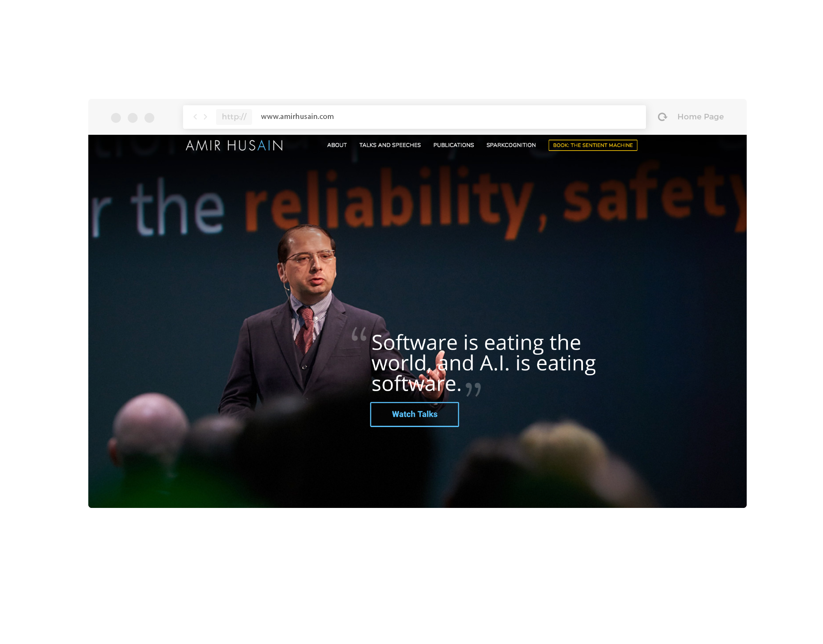

TO LEARN MORE
amirhusain.com
sparkcognition.com
@amirhusain_tx

